Slide 1
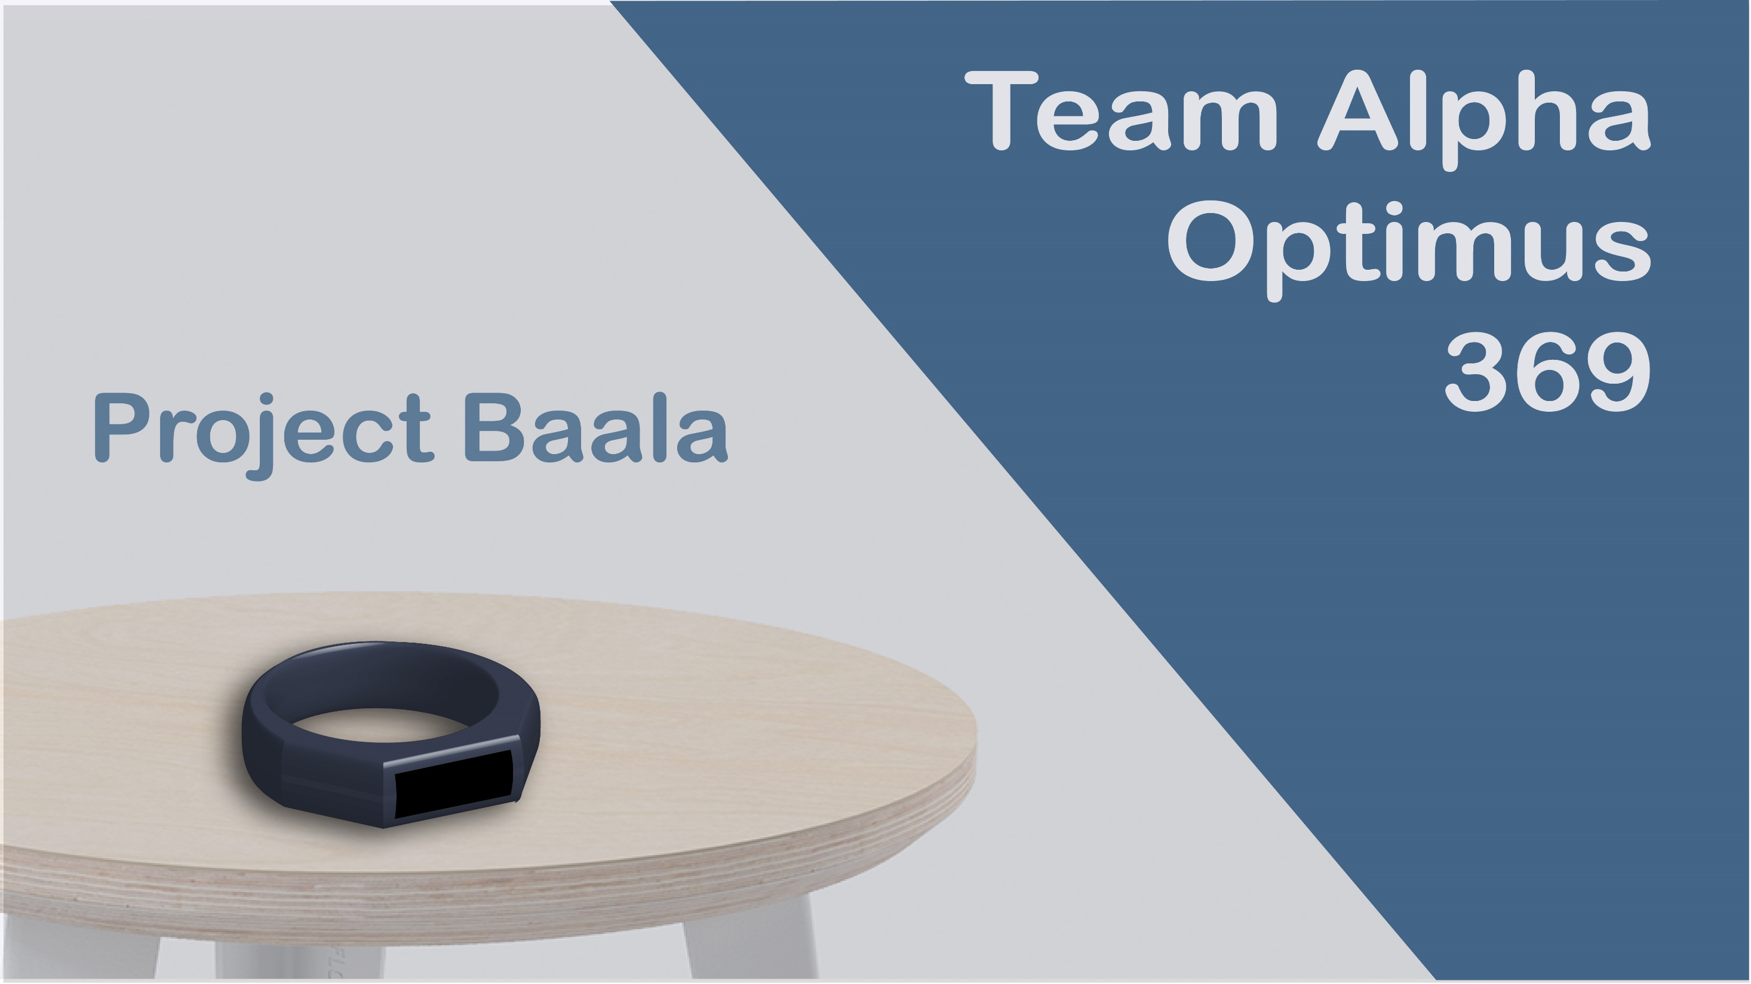

Slide 2
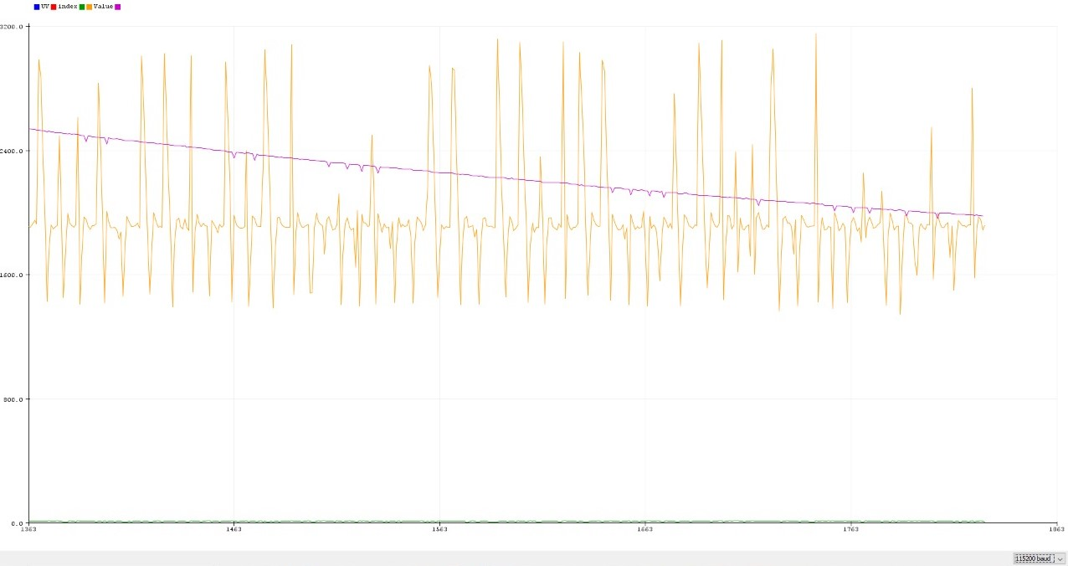





Slide 3
Slide for video

Slide 4
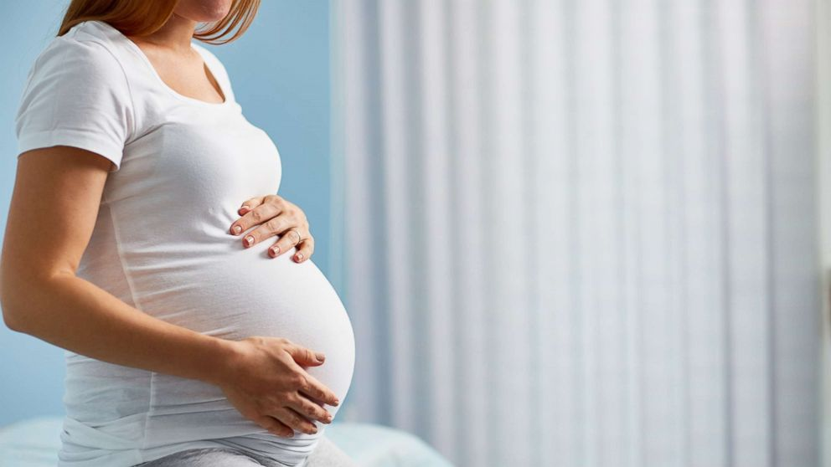
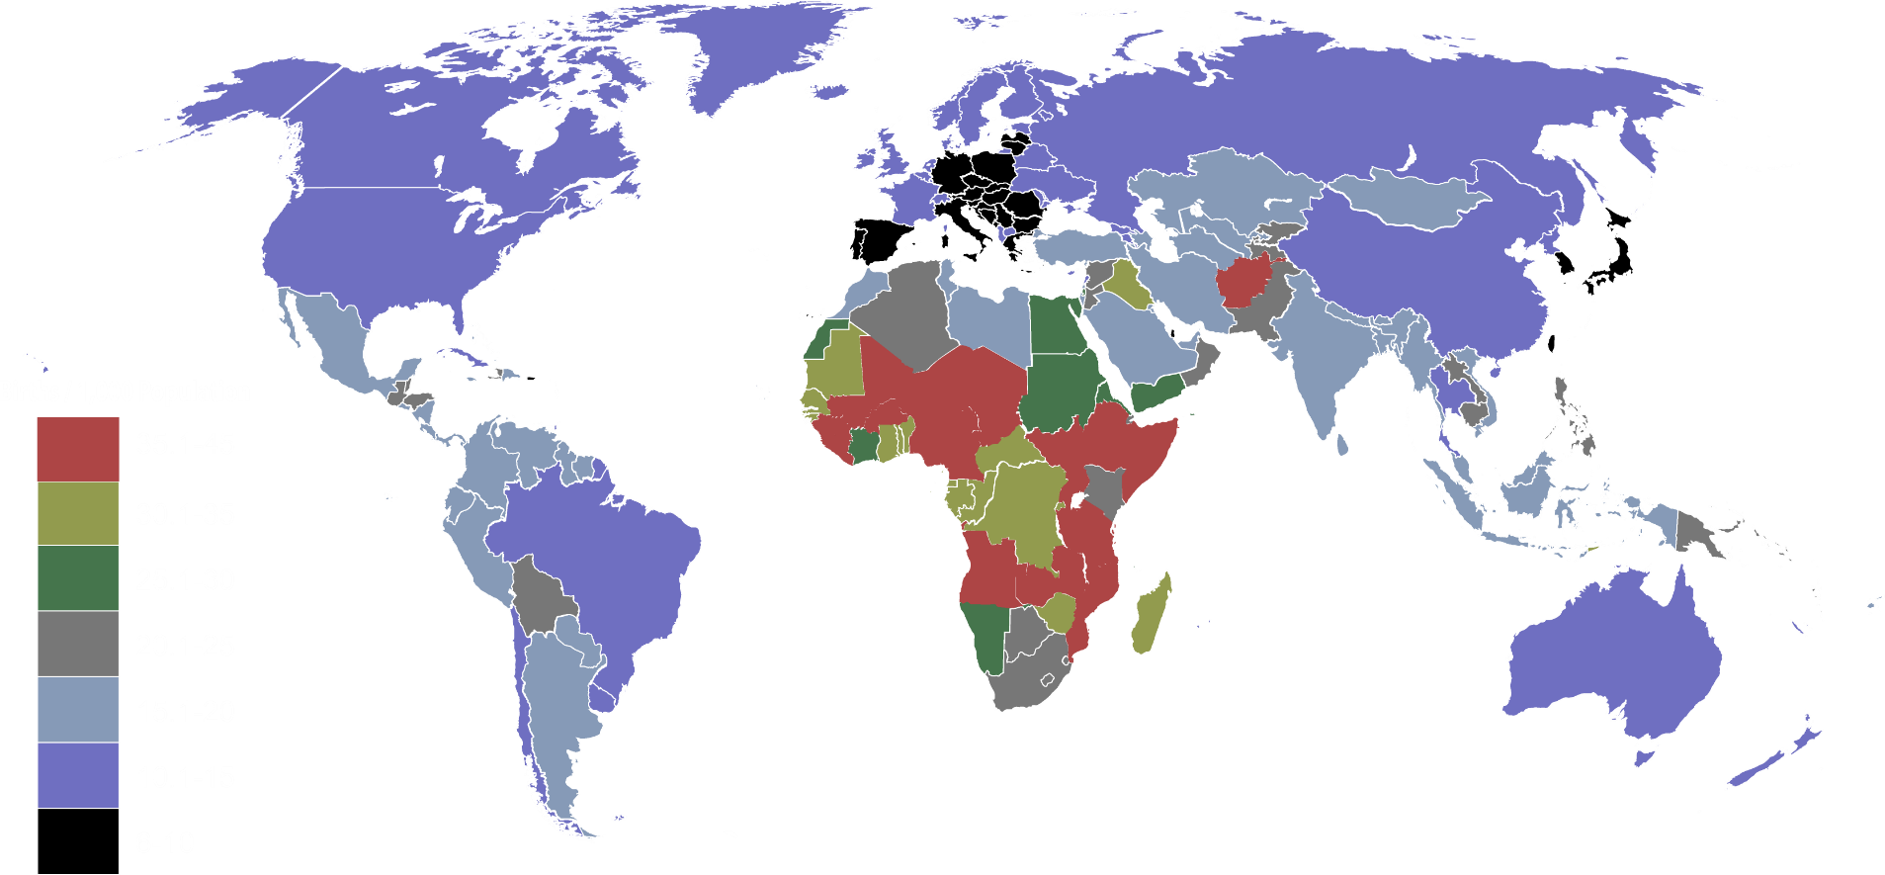
Countries by birth rate in 2017

Slide 5
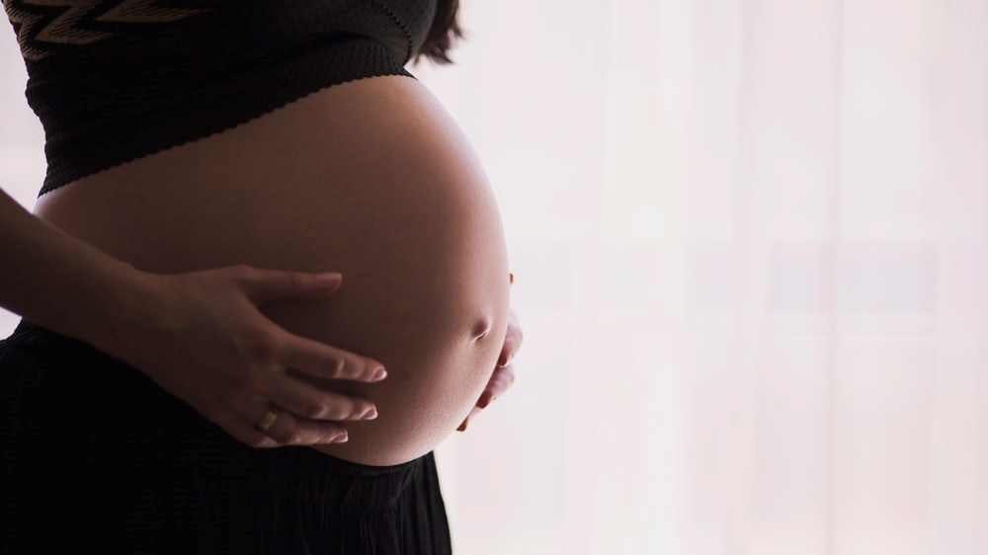
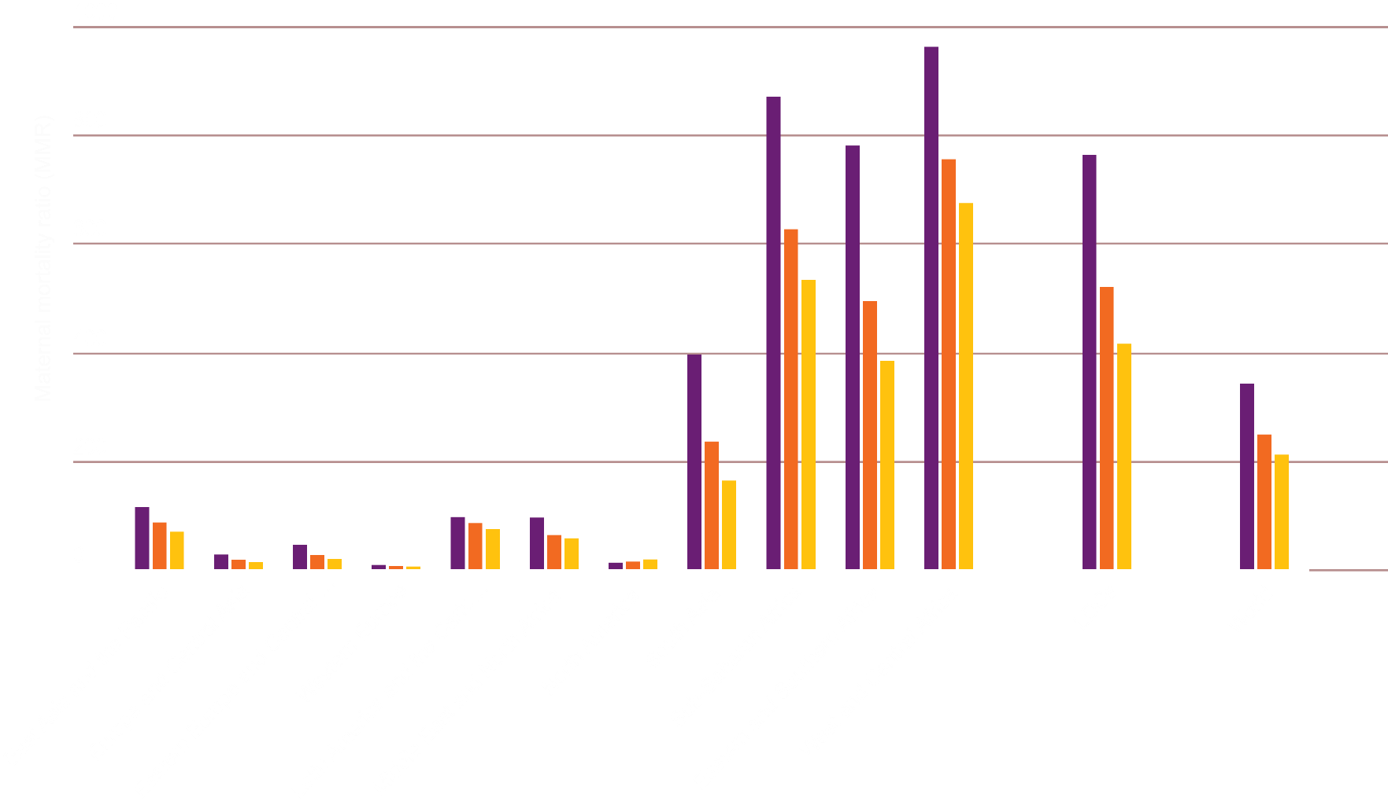
Maternal Mortality ratio
2000
2010
2017

Slide 6

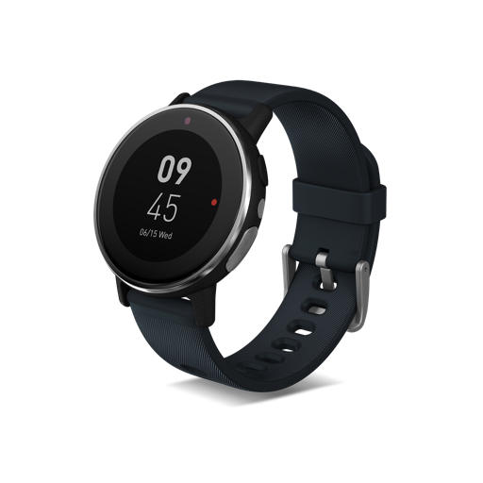
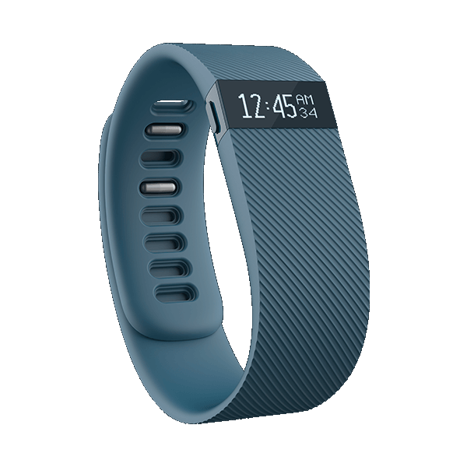
Trends
Fitbit Charge
Price: 23,000 BDT
Acer Leap Ware
Price: 16,200 BDT

Slide 7
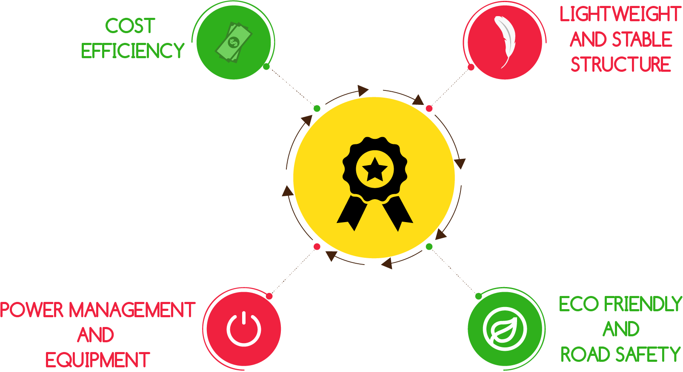

Challenges

Slide 8

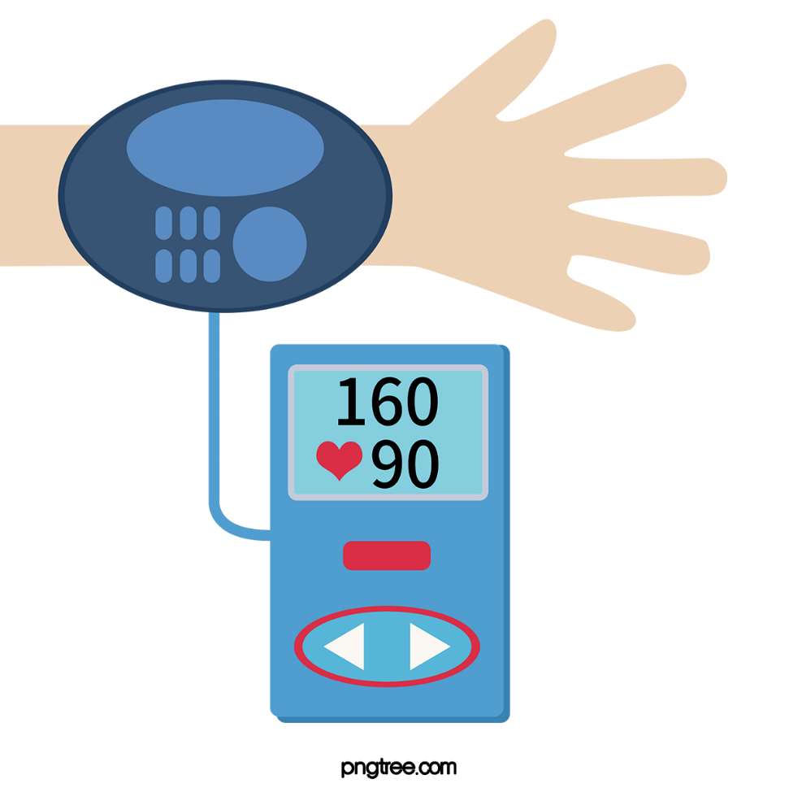
Problems
Scheduled Monitoring of body temperature, bpm and blood pressure could not be done.

Slide 9
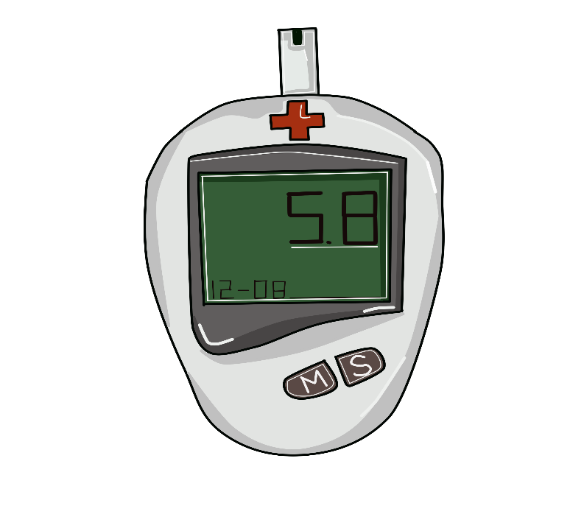
Lack of proper monitoring of UV index level can hamper a pregnant woman and her child.

Slide 10
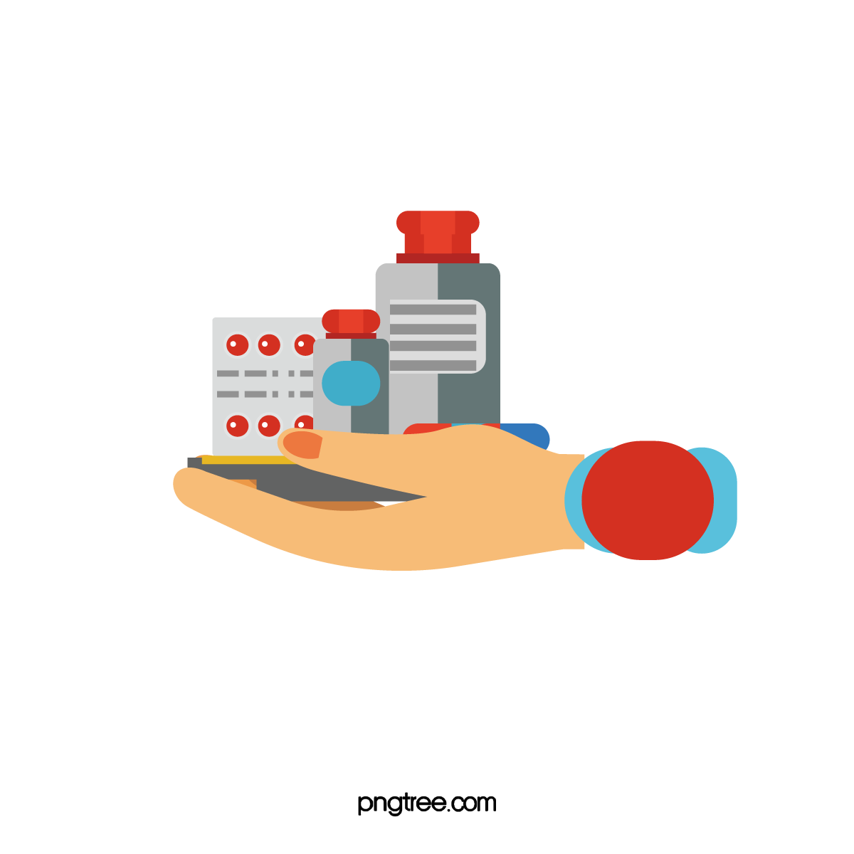
Medicine specially anti biotics need to take in proper time. If it does not than it could develop anti resistant for a disease.

Slide 11

Proper nutrition taking is a must for pregnant woman and her child's health.

Slide 12





Steps we need to take
Continuous monitoring of temperature
Scheduled monitoring of UV ray index
Scheduled monitoring of bpm and blood pressure
Maintaining schedule for medicine
Emergency service

Slide 13

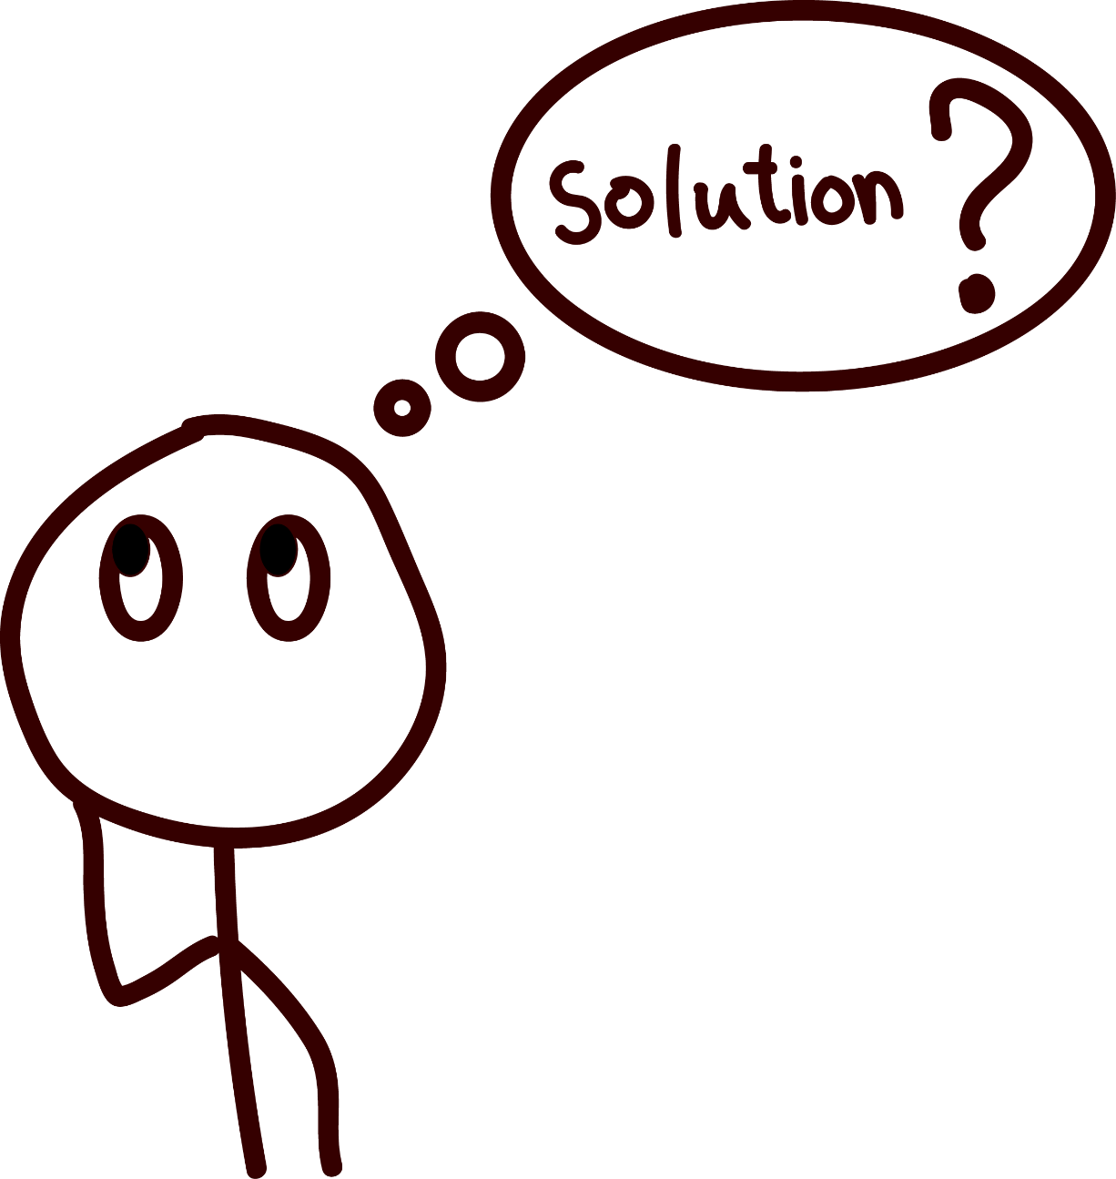

Slide 14
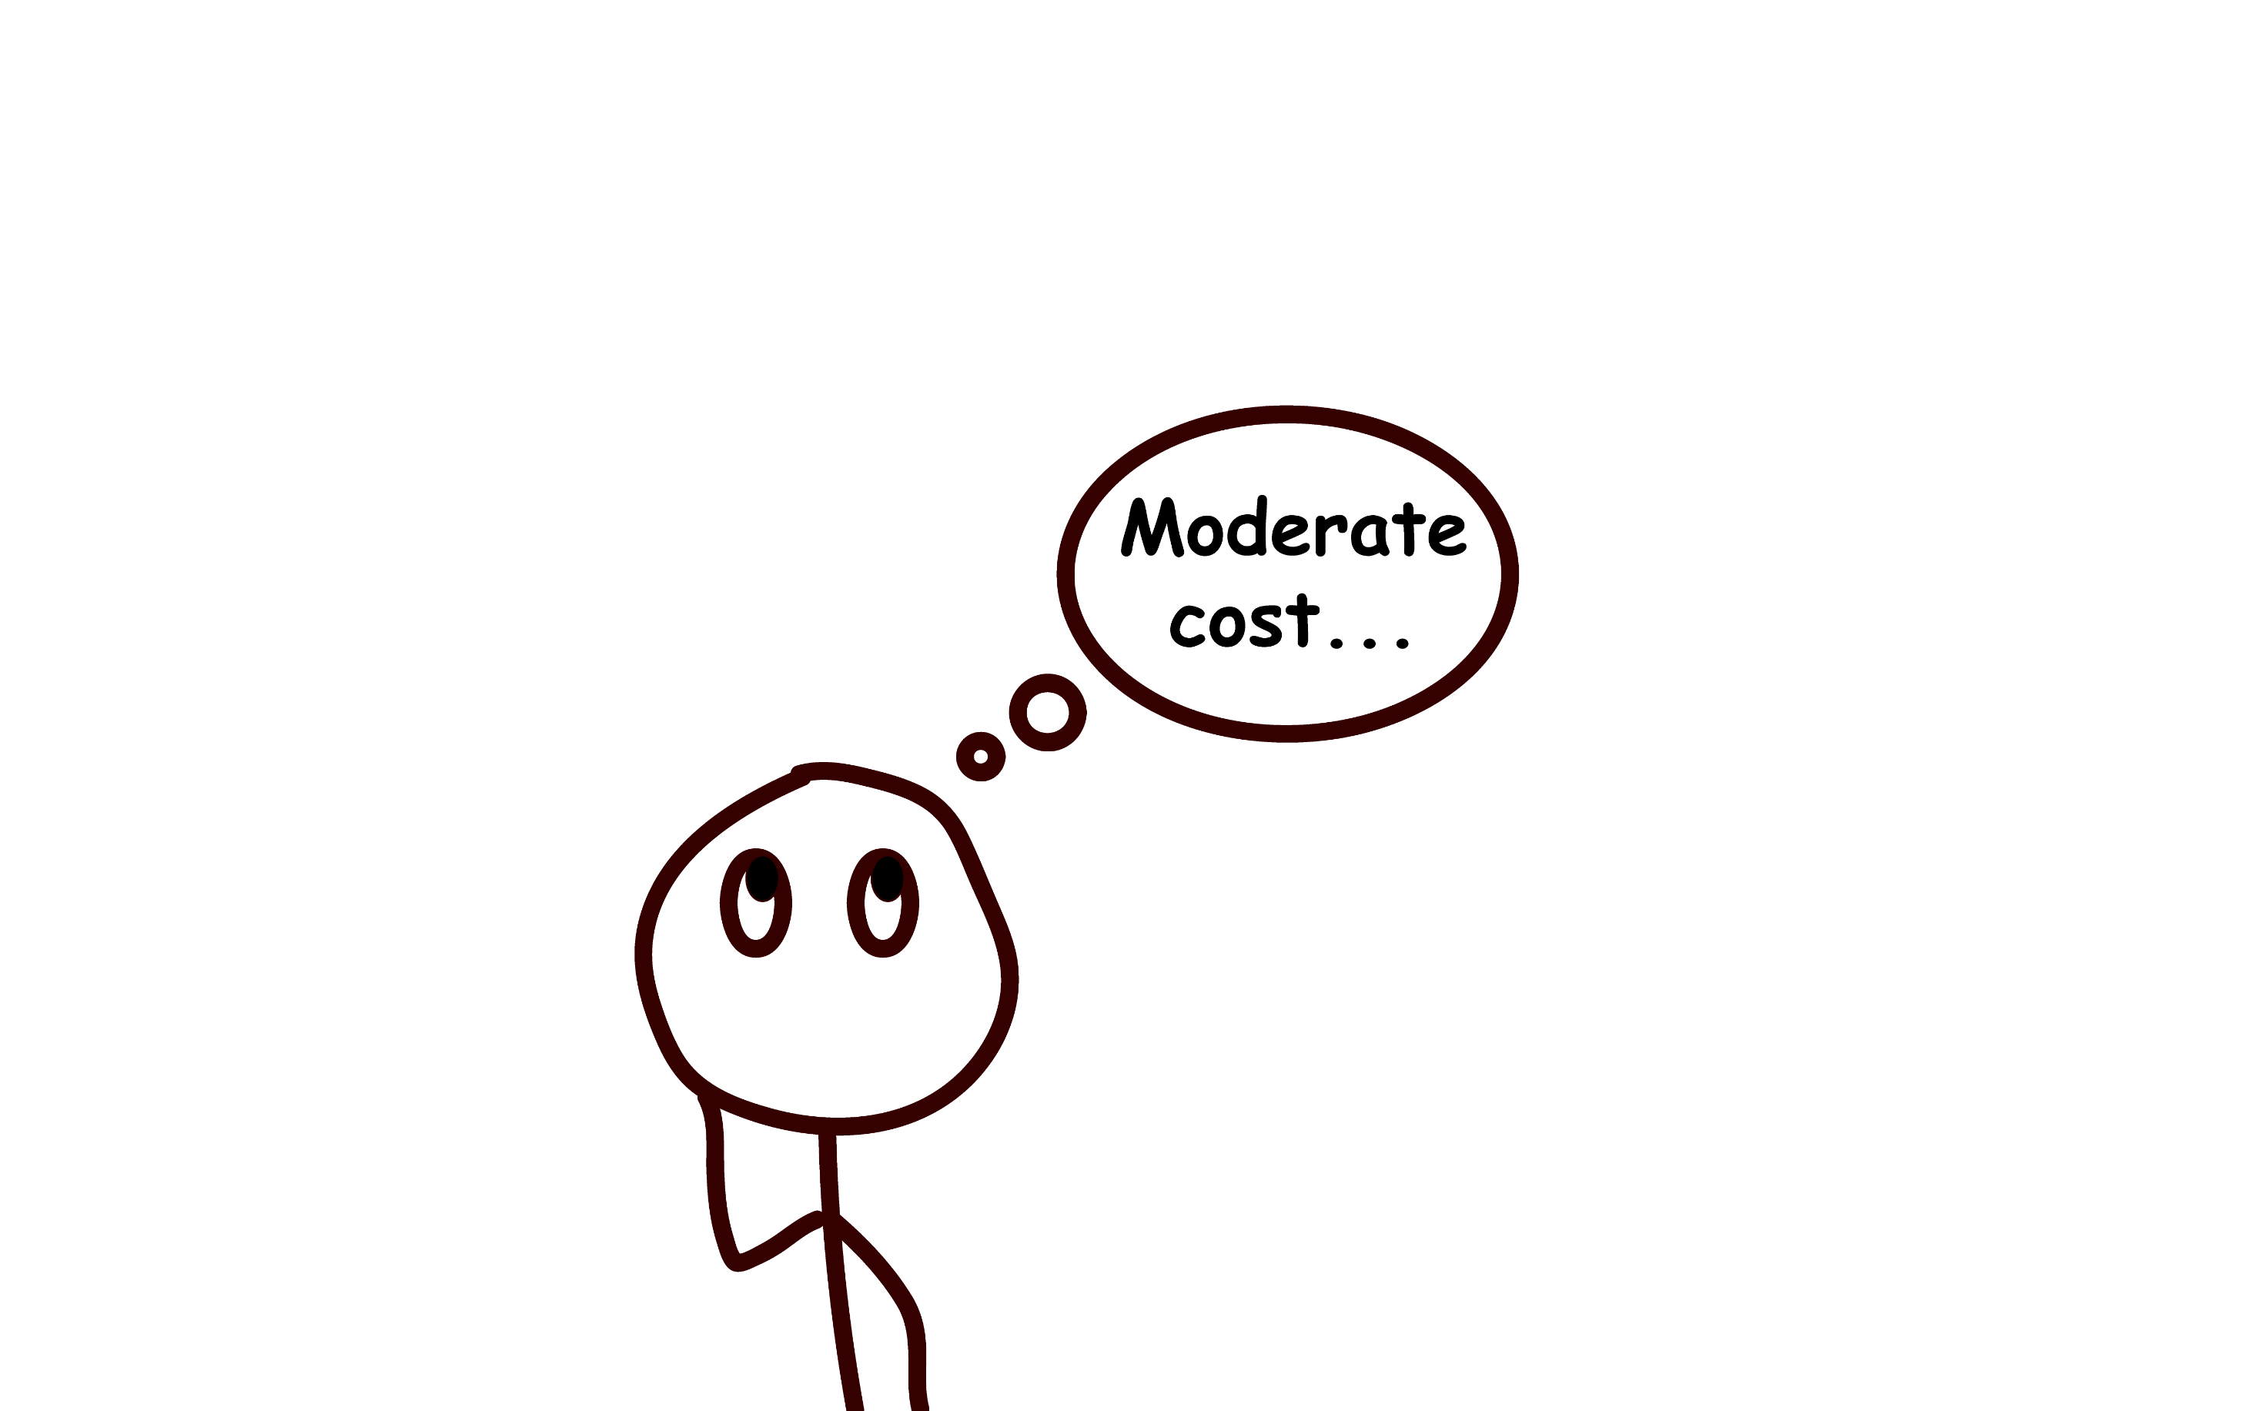


Slide 15
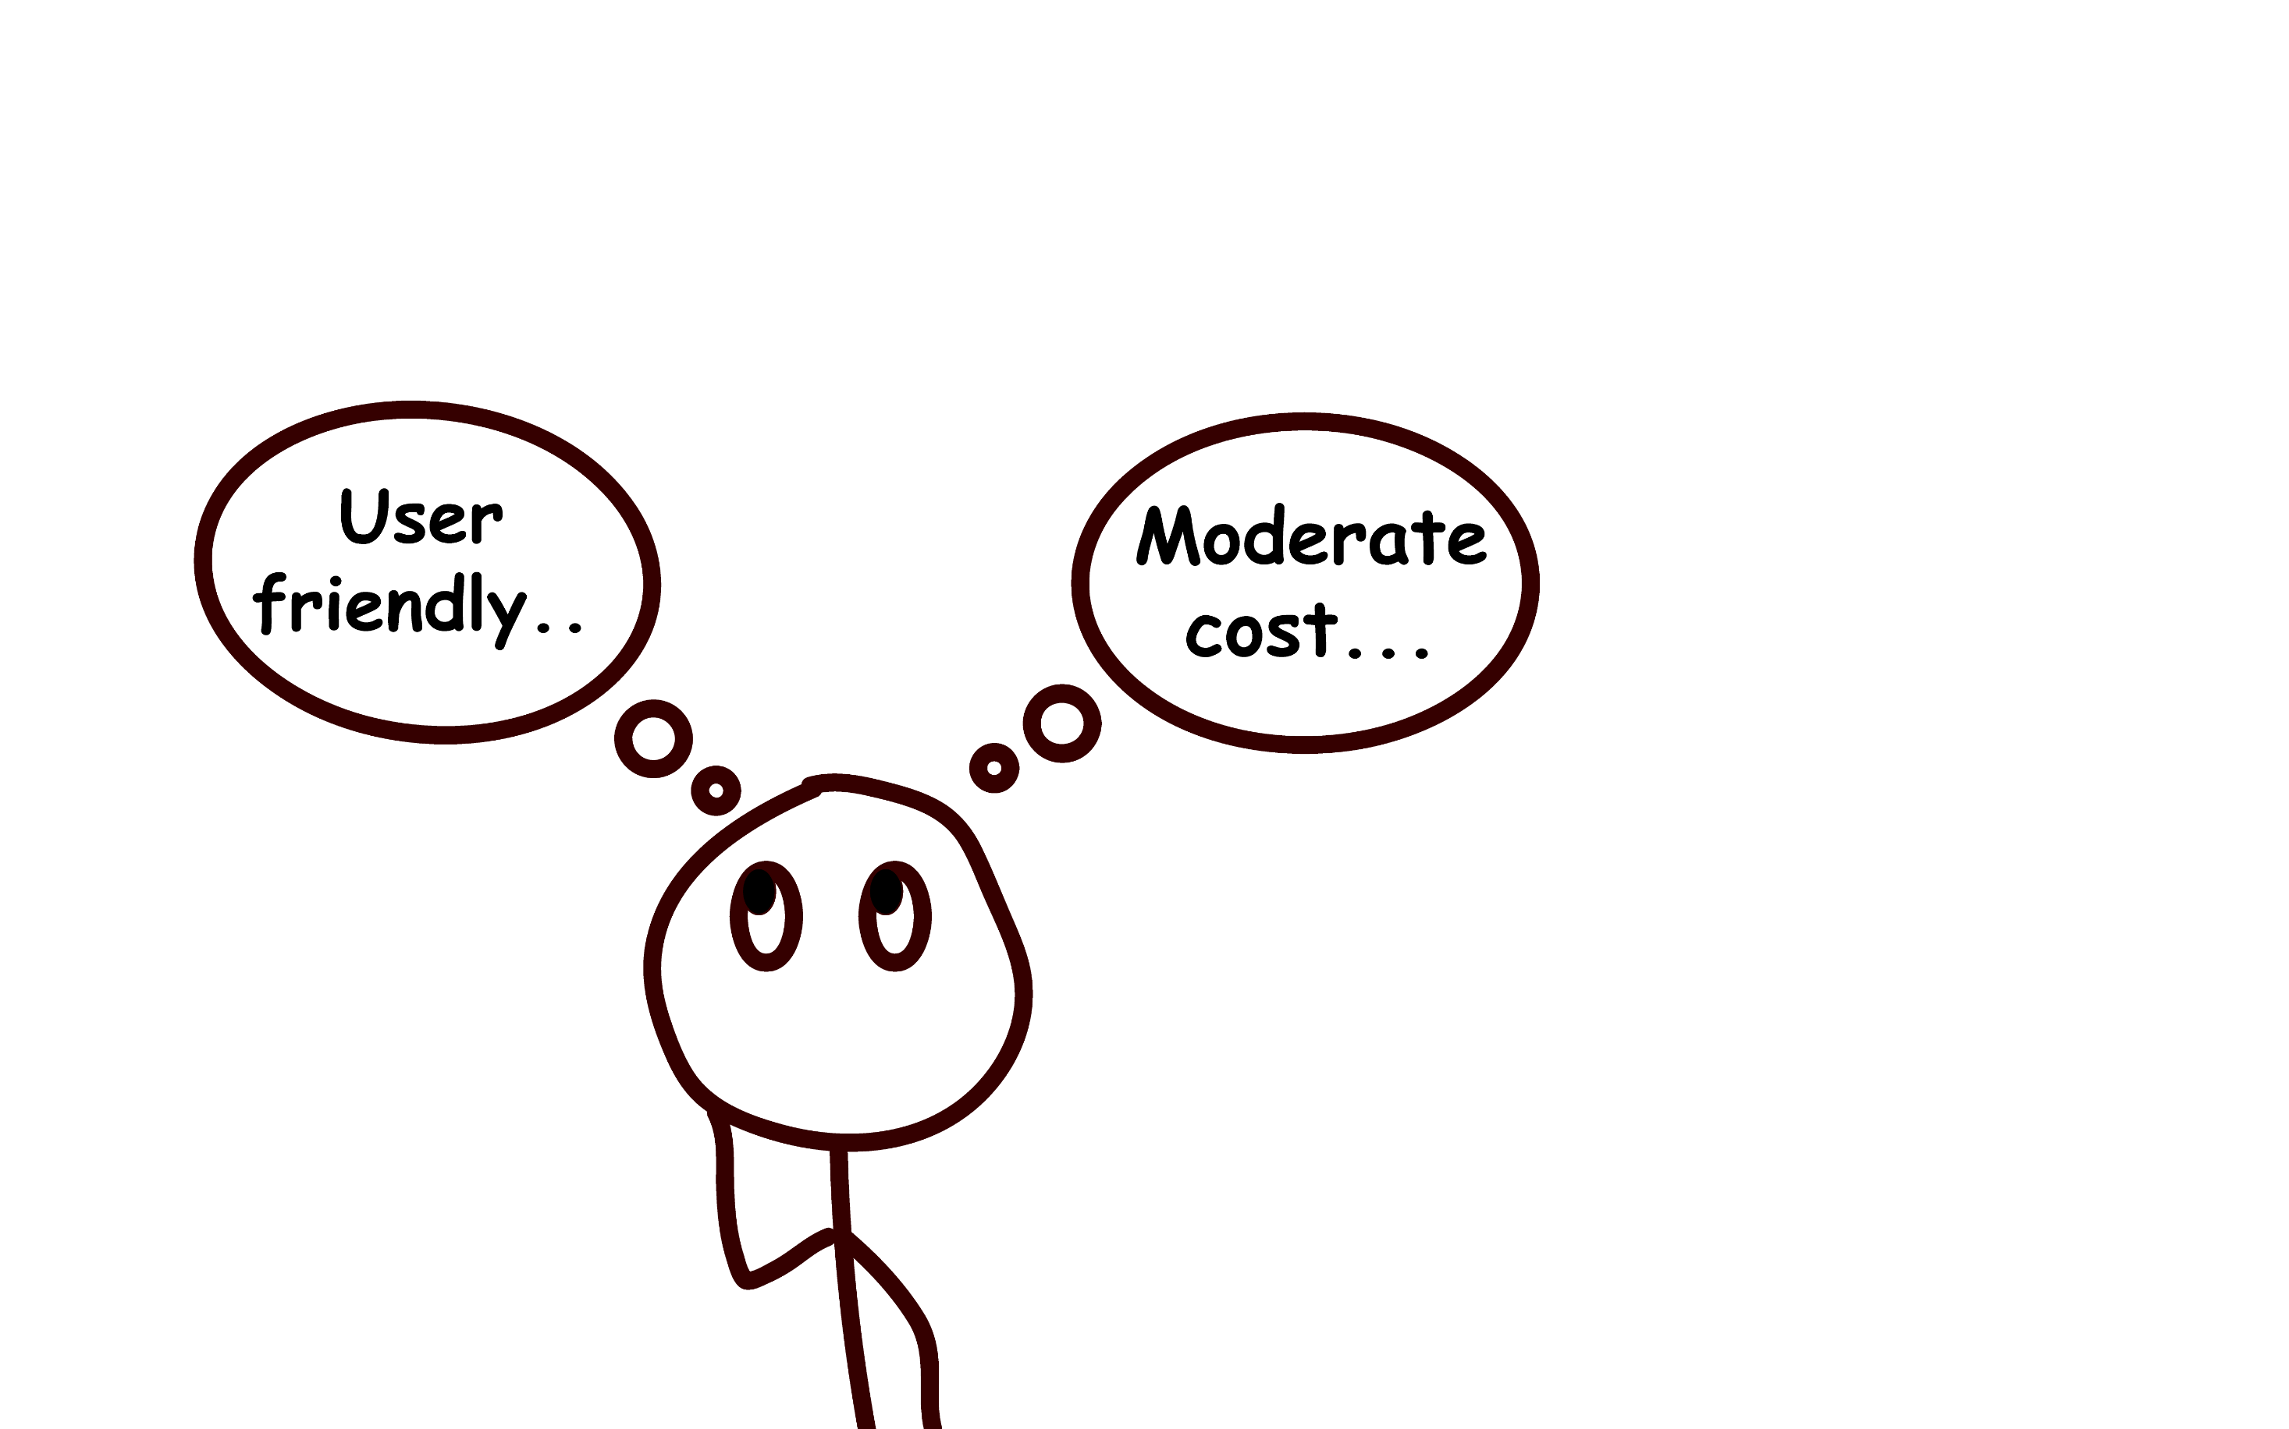


Slide 16
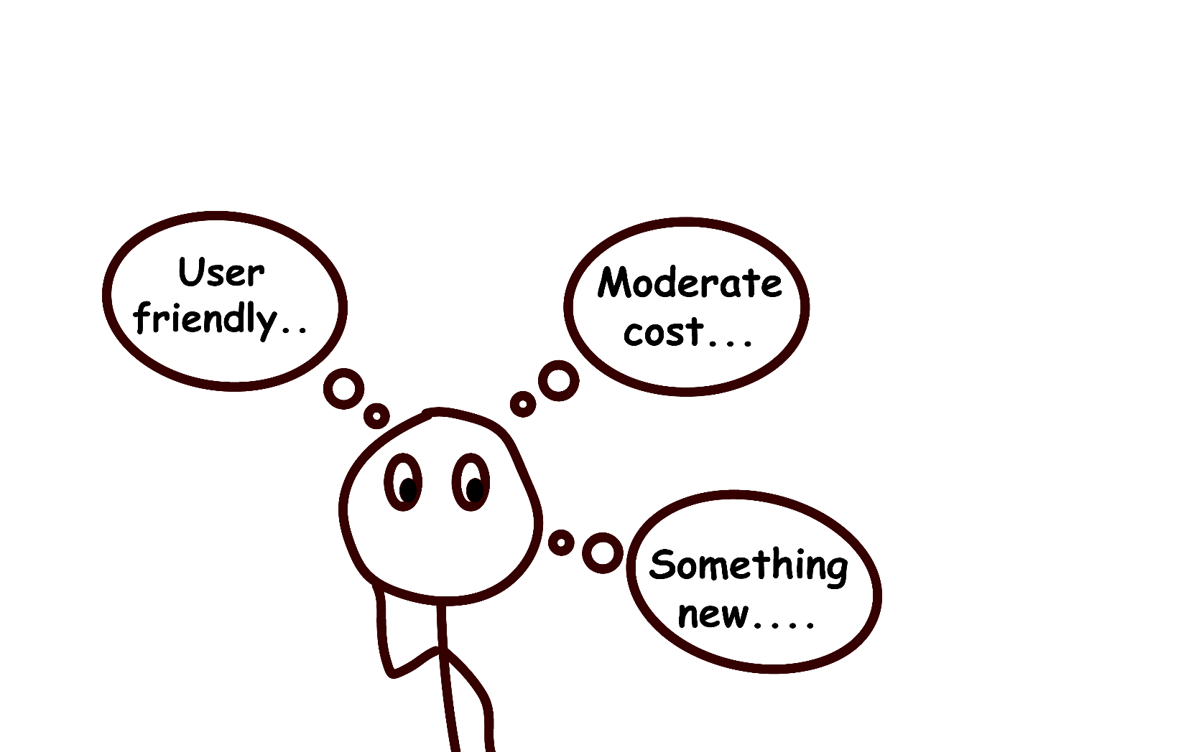


Slide 17

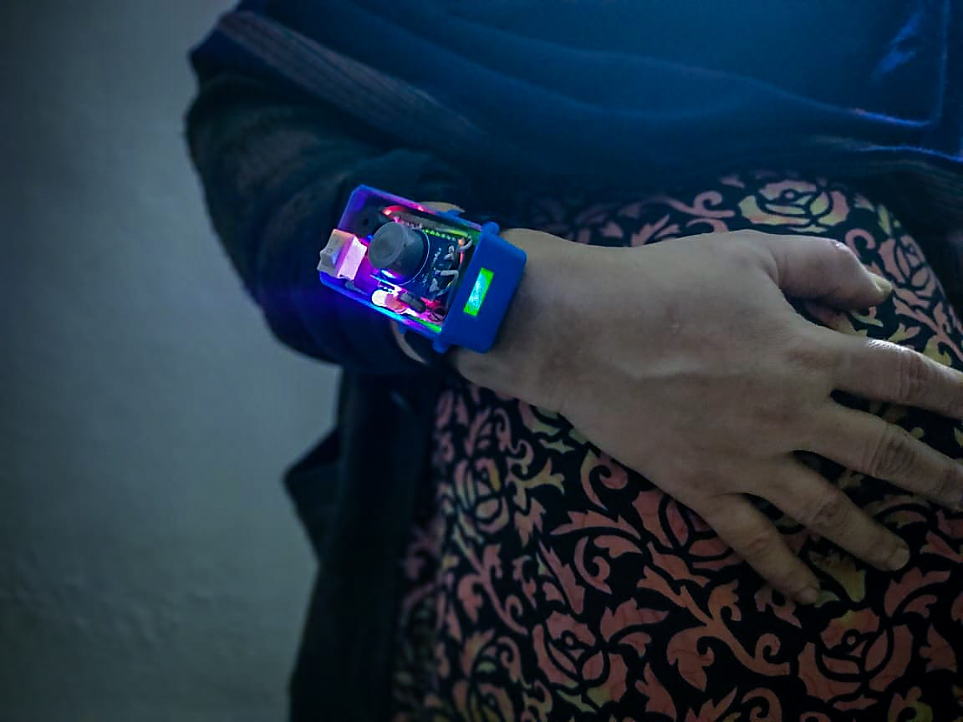
BAALA
By using few particular components, we leap forward to create a BAALA after solving all the challenges.

Slide 18
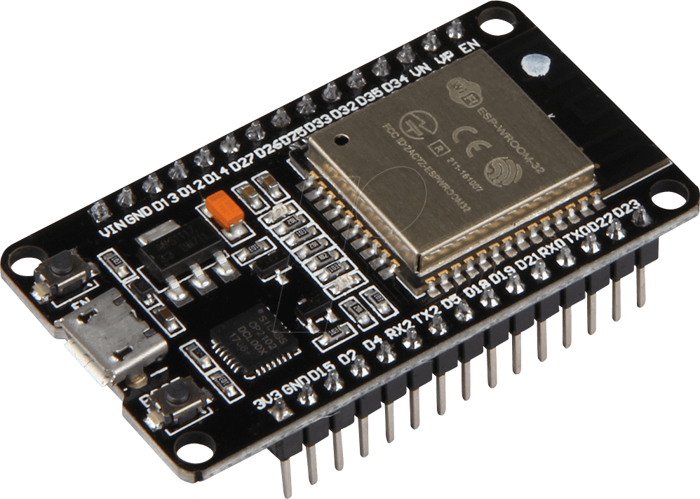
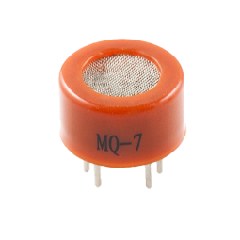
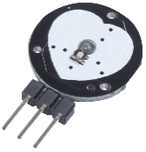
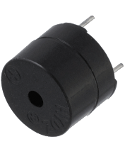
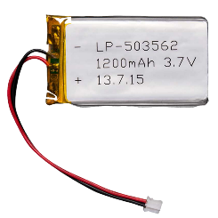
Components
ESP 32
Co sensor
Pulse sensor
Buzzer
Lipo 1200 mAh

Slide 19
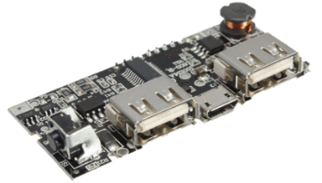
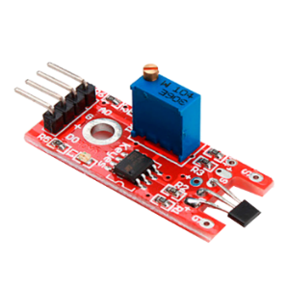
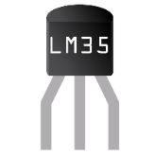

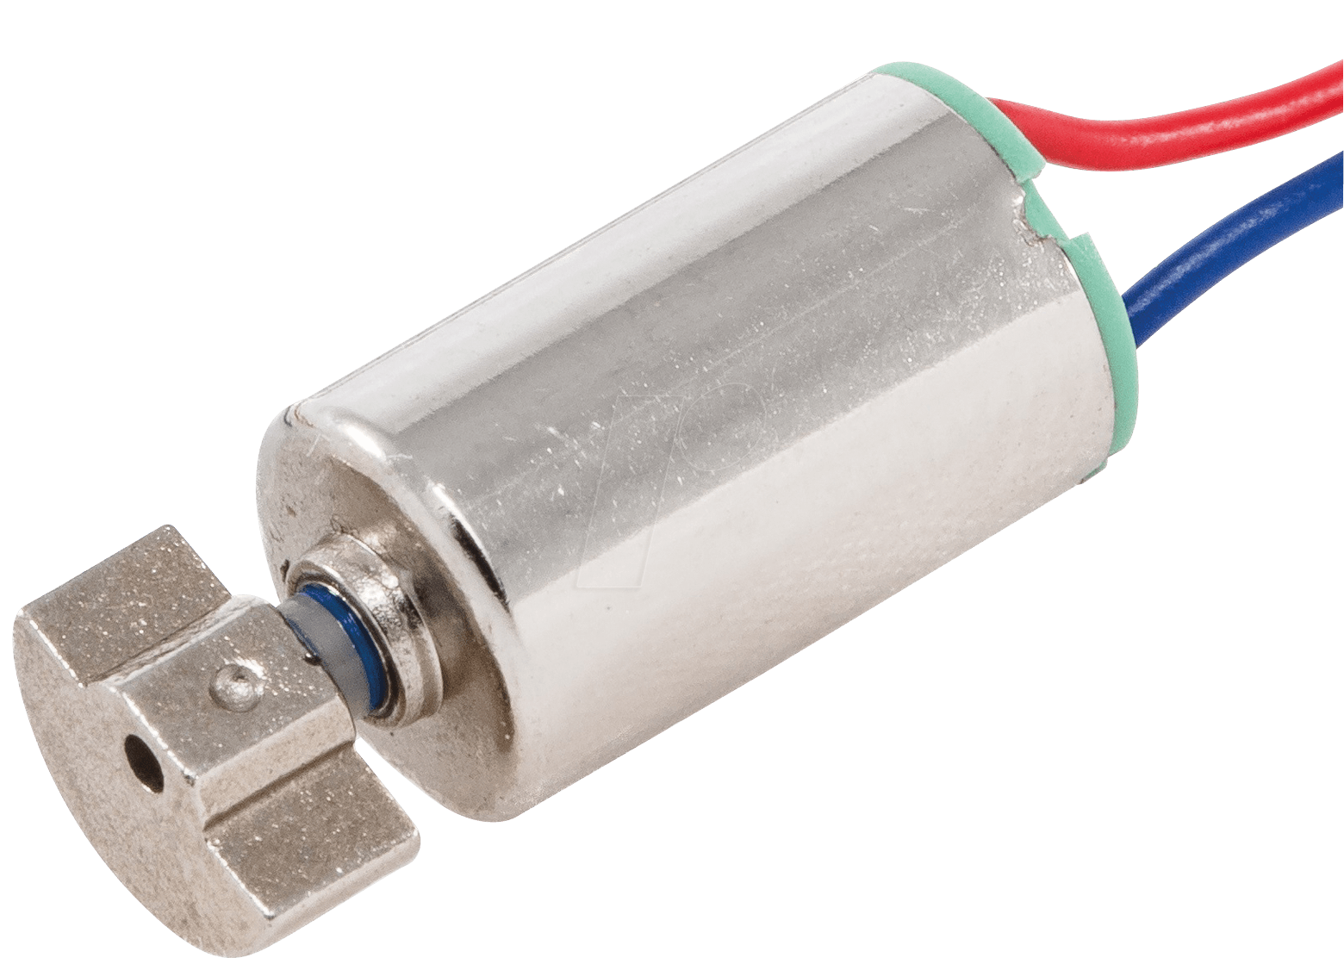
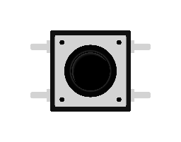
Integrated power bank circuit
Internally built in hall effect sensor
Temperature sensor LM35
Built in Bluetooth
Vibrator
Special switches

Slide 20
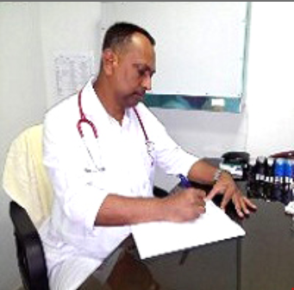
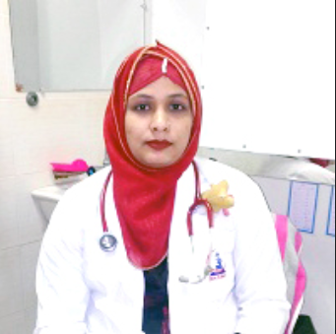
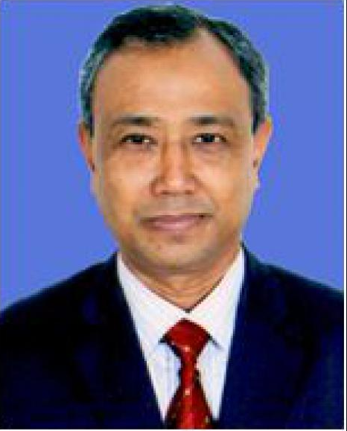
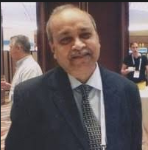

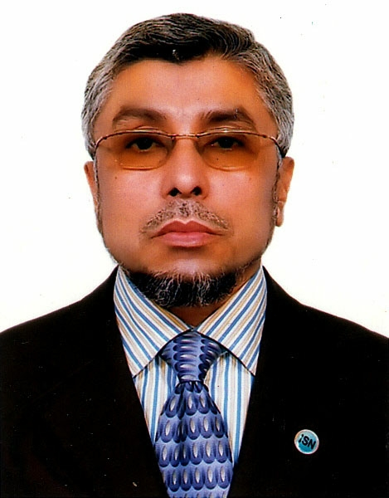
Name : Dr. Md. Al-Amin Mridha
Designation : Consultant
Name : Dr. Md. Atiqul Islam
Designation : Consultant
Name : Dr. Bodhrun Naher
Designation : Consultant
Name : Professor Dr. Afiqul Islam
Designation : Professor
Name : Professor Dr. Selim Shakur
Designation : Consultant & Head of Department of Pediatrics
Name : Prof. Dr. Golam Muin Uddin Designation : Professor, Child Specialist

Slide 21
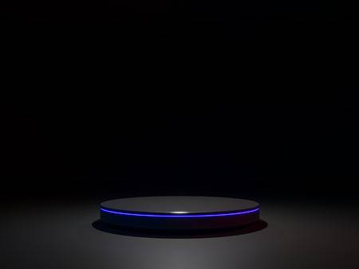
WORLD’S FIRST
digital device
87%
Accuracy
Starting from
03$
75%
Price reduced

Slide 22
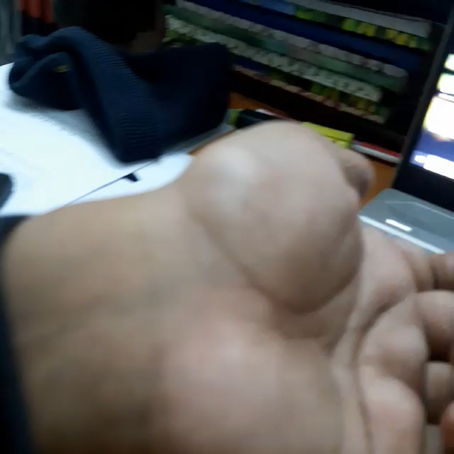

Slide 23

Balanced scorecard slide 5
Cost Breakdown
COMPONENTS
BDT
USD
RUPEES
TOTALS : 784/-
320/- 3.78 $ INR 269
ESP 32
65/- 0.77 $ INR 54.69
MQ-7
90/- 1.06 $ INR 75.72
PULSE SENSOR
250/- 2.95 $ INR 210.33
LIPO BATTERY 3.7V
RECHARGEABLE CKT
20/- 0.24$ INR 16.83
BUZZER & VIBRATOR
39/- 0.47$ INR 33.65

Slide 24
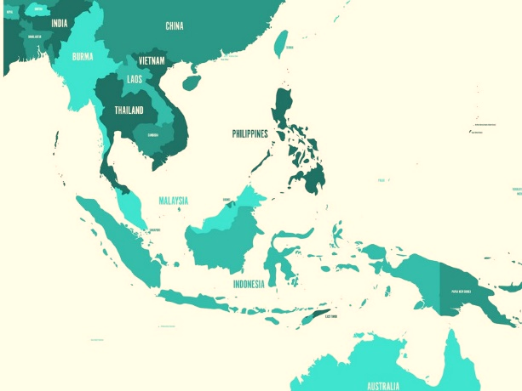
Best Countries Market for Baala
INDIA
South East Asia
NORTH AMERICA

Slide 25
Global Market
It may be for rural people, but it has global market
57M
99M
8.6M
36M
5M
UAS: 104 Million
Africa: 8.6 Million
Asia: 57 Million
Australia: 36 Million

Slide 26
Roadmap and Future Development

